Slide 1
FDI India
File created on: 30-04-2021 10:54:31

Slide 2
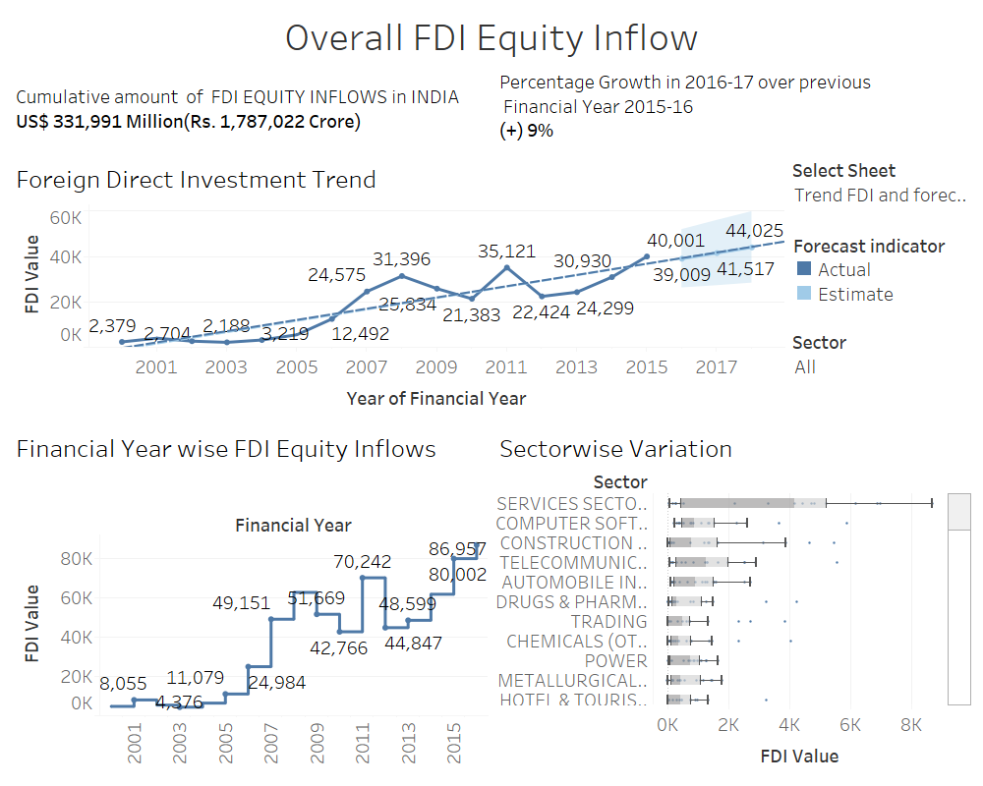

Slide 3
